Slide 1
Club Coach Training
The First Class
Club Coach
218F

Slide 2
Agenda
Club coach qualifications
Why a club coach is needed
How to be an effective club coach
1

Slide 3
Smedley Award
Program Dates: August 1 – September 30 Can your club add five new, dual, or reinstated members with a join date between August 1 and September 30? Accomplish this goal and you’ll qualify to receive a Smedley Award ribbon, named in honor of Ralph Smedley, which you can display on your club’s banner. Qualifying clubs can also earn a special discount code for 10% off their next club order. (The discount code expires six months from the date of issue and is not valid with any other offer.) Applications and payments for members with a join date between August 1 and September 30 must be received at World Headquarters or online no later than September 30. The addition of transfer and charter members does not count toward Smedley Award credit. The winning clubs will be revealed online within a few weeks of the submission deadline. Winning clubs should allow up to 10 business days to receive their award if they are located in the United States, and up to 21 business days if they are outside of the United States.
Notes:
- DCP Goal 7
- Helps with on-time payments

Slide 4
Why Do U want to Be a Club Coach
Think back to when you first joined Toastmasters. Do you remember what motivated you to become a member? Share your story with the world and help inspire others!.
Notes:
Develop leadership skill giving back

Slide 5
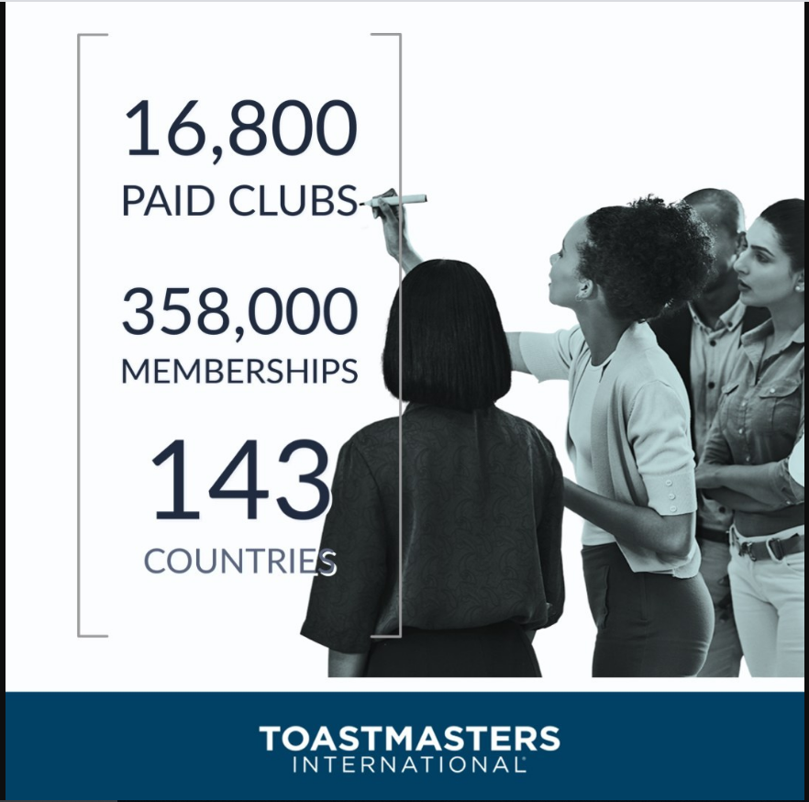
About Toastmasters International

Slide 6
What is Ur Why

Slide 7
What is Ur Why

Slide 8
What is a Club Coach
A club coach is an experienced Toastmaster who coaches a club to rebuild membership and restore quality to the club environment.

Slide 9
A Club Coach Responsibilities
Builds a rapport
Observes and analyzes the club environment
Helps the club develop goals
Enables the club to achieve goals
Instills enthusiasm, fidelity, and a sense of responsibility
2

Slide 10
Club Coach Qualification
The coach may not be a member of the club at the time of appointment, but may join the club after being assigned. The club must have 12 or fewer individuals who have paid for membership at the time of the appointment.
4a

Slide 11
What does Success Look Like?
To be considered for recognition, your club must either have 20 members or a
net growth of at least five new members as of June 30, 2021. Transfer members do
not count toward this total until their membership has been paid and is current
in their new club.
Achievement | Recognition Earned
Achieve 5 of the 10 goals | Distinguished Club
Achieve 7 of the 10 goals | Select Distinguished Club
Achieve 9 of the 10 goals | President’s Distinguished Club
3

Slide 12
What does Success Look Like?
Education | Membership | Training | Administration
1. Four members complete Level 1 in a learning path | 7. Four new members | 9. A minimum of four club officers trained during each of the two training periods | 10.On time payment of membership dues accompanied by the names of eight members (at least three of whom must be renewing members) for one period and on-time submission of one club officer list.
2. Two members complete Level 2 in a learning path | 8. Four more new members
3. Two additional members complete Level 2 in a learning path
4. Two members complete Level 3 in a learning path
5. One member completes Level 4 or Level 5 in a learning path or DTM
6. One member completes Level 4 or Level 5 in a learning path or DTM
3

Slide 13
Who is going to do the work?
Not just you! That’s the good news. To be successful, you’ll need some help. The club’s officers and members, the club coaches, the area director, and other district leaders make up the Club Rescue Team, and they must work together if the venture is to be successful. In most cases, the club coaches will coordinate the actions that are to be taken.
4b

Slide 14
Two Types of Actions
Internal Actions
External Actions

Slide 15
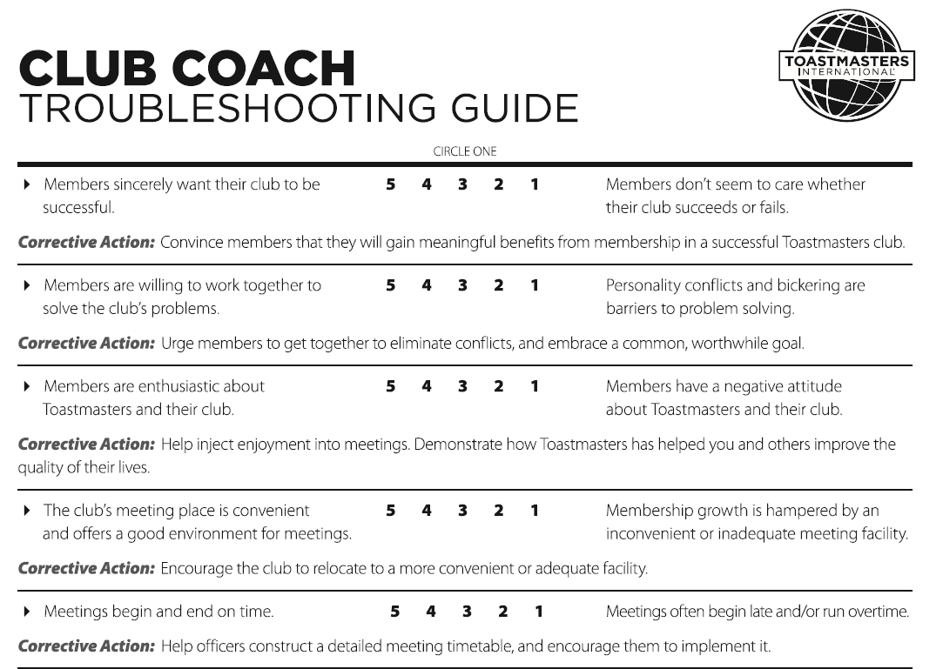
Internal Actions
5

Slide 16
Internal Actions
Meeting Time, Place, & Location
Club Meetings and Club Roles
Guest and Current Members
Officers
Achievements
5

Slide 17
Meeting Time, Place, & Location
Does the club meet downtown in the late evening? In the morning in a suburbs? Is the building easily accessible? Is the parking lot well-lit? Too many steps? Bad neighborhood? Too noisy? Often changing the meeting time, place, and/or location has a major positive impact on the club’s rebuilding efforts.
5

Slide 18
In a successful club meeting:
Teach the club how to plan and produce club meetings.
Ensure the vice president education reviews the Club Leadership Handbook.
Show club leaders how to find and use other tools.
8

Slide 19
Teach Club Meeting Roles
Toastmaster
Speaker
Evaluator
Table Topics Master
General Evaluator (Example)
Timer
WAG (Grammarian, Ah-Counter)
10

Slide 20
Guests…Guests…Guests
Make guests feel welcome! The first steps of your action plan will bring prospective members to your club, but getting them to the club meeting is only the first step. If they are to return and join the club, they must receive personal attention.
7

Slide 21
Officer Preparedness
Encourage the use of the Club Leadership Handbook (Item 1310), and other manuals to solve problems. Be sure the club officers are thoroughly familiar with all educational and promotional materials and that they understand the proper handling of important administration tasks, such as semiannual reports, club officers lists, etc., that must be completed and submitted to World Headquarters on time.
9

Slide 22
Recognize Achievement
Emphasize the importance of recognizing members.
Encourage corporate clubs to use the company email, intranet, and newsletter to recognize members.
Publicize the club’s achievement in the Distinguished Club Program.
14

Slide 23
External Actions
Attracting New Members
Membership Programs
Public Relations
5

Slide 24
Attracting New Members
All low-membership clubs share one thing – too few members! Part of your responsibility in rescuing these clubs is finding new members. Here are some ideas to help you attract the new members your club needs. First, and most importantly, make sure your meeting location is suitable for a dynamic meeting. It should be convenient, have adequate space, and be free of distractions such as music and other noises. Place a Club Meeting Plaque (Item 384) in the entrance hall.
5

Slide 25
Membership Programs
Bring a guest win a prize campaign
I want to encourage club coaches to create there own campaigns.
5

Slide 26
Public Relations
Eventbrite
Meetup
Facebook
FreeToasthost
5

Slide 27
Looking to the Future
A vision is what members want their club to become.
Help members develop a vision for the club.
Get their agreement to fulfill the club mission.
Guide the club to set specific goals.
15

Slide 28
Looking to the Future
Club mission
We provide a supportive and positive learning experience in which members are empowered to develop communication and leadership skills, resulting in greater self-confidence and personal growth.
16

Slide 29
Looking to the Future
Teach the club how to use the Distinguished Club Program and Club Success Plan.
17

Slide 30
Closing
"While most of us may have entered Toastmasters to learn to make speeches, that benefit is but the beginning of the good which may come to us and the good which we may do for mankind."
–Ralph Smedley (Toastmaster Founder)
19

