Slide 1
Jeanna Lee
PRM@d27-tm.org
202-909-3057

Slide 2
Seth Godin

Slide 3
How to Promote and Publicize Your Club
Mass Media
Social Media
Newspaper
Arlington Now
Washington Post
Alexandria Times
Local TV Stations
Arlington County Local
Radio
WHUR
WAMU
Podcast
Blog
FreeinDC
Twitter
Instagram
Snapchat
TikTok
LinkedIn
Eventbrite
MeetUp*
Facebook
Pages
Groups
https://www.facebook.com/groups/375980083030402

Slide 4
Theme of the Story - S.O.A.P.
Speaker
Who is the speaker?
The voice that tells the story/speech
The speaker(s) will establish the tone or mood of how the meeting proceeds
Occasion
What is the occasion?
The time and the place of the club meeting
Audience
Who is the audience?
The members, guests, and any other attendees to whom the speaker is directing the speech
Purpose
What is the purpose?
The reason behind the speech

Slide 5
Applying S.O.A.P.
Speaker – Your club via your VPM or VPPR
Occasion – Club Meeting or Open House or Special Event
Audience – varies based on which social media platform you use
Purpose - varies based on which social media platform you use

Slide 6
Applying S.O.A.P.
Twitter – tweets (short messages and updates)
Instagram – photos and videos
Snapchat – temporary photos and videos
TikTok – short videos to highlight club
LinkedIn – professional networking
Eventbrite – event registration and advertising
MeetUp – event registration and group
Facebook – group and announcements

Slide 7
The 5 E’s of Social Media

Slide 8
Free Website Builder Platforms
Wix
Create an account at wix.com
WordPress
Create an account at wordpress.com
District 27
FreeToastHost
Request a website at https://www.toastmastersclubs.org/welcome/
Impact 21
EasySpeak Register for a website at https://www.toastmastersclubs.org/welcome/

Slide 9
Video Teleconferencing Platforms
Zoom
GoToMeeting
Skype
Google Hangout

Slide 10
Video Teleconferencing Platforms
WebEx
Microsoft Teams
Facebook Chat
Face Time

Slide 11
Video Teleconferencing Platforms
The club president, the secretary, and the treasurer should have access to the video teleconferencing account.
The club president to set the agenda.
The secretary to send the link.
The treasurer to ensure payment (if there is a fee).
Make sure members and guests get the correct link at least 48 hours before the meeting/event and send a reminder the day of the meeting/event. Include all relevant information such as the link and any passcode or security measures.

Slide 12
Newsletter and Email ListServ
Consider creating a monthly or even quarterly newsletter for your club to send to members and to include in guest packets.
You can download a free newsletter template form Toastmasters International at https://www.toastmasters.org/resources/newsletter-template.
MailChimp
ConstantContact
https://mailchimp.com/pricing/
Free account
Can upgrade to Essentials or Standard account
https://www.constantcontact.com/pricing
Email Marketing is $20/month while Email Plus is $45/month

Slide 13
Podcast Hosting Sites
Anchor
anchor.fm
Free
ITunes
https://podcasts.apple.com/us/genre/podcasts/id26
Google Podcast
https://podcasts.google.com
BuzzSprout
https://www.buzzsprout.com/1258574/episodes
Free for up to 2 hours
$12/month for 3 hours
Spotify
spotify.com

Slide 14
How to make a podcast
Develop Your Team
Develop Episode Themes and Topics
Sign up for podcast hosting site
Get a recording and sound editing program (Zoom and Audacity are free)
Set Up Date and Time for first podcast recording

Slide 15
Event Registration and Promotion
Eventbrite
eventbrite.com
Evite
evite.com
MeetUp
meetup.com
Free to join but must pay subscription to post
Facebook Event
facebook.com

Slide 16
Event Registration and Promotion
To keep track of attendance
To gather contact information from guests and visitors for follow-up
To see analytics of which events were popular
To send out evaluation surveys of attendees’ thoughts and suggestions
To record memories of past events
At events/meetings, someone should be in charge of taking photos or recording videos.
Secretary should also be taking minutes.

Slide 17
Photo and Video Sharing Websites
All free (but some may require a fee for more storage space)
Google Photos
photos.google.com
Connected to Google account
Amazon Photos
www.amazon.com/photos
Must have Amazon Prime and connected to Amazon account
Flickr
flickr.com
Free to sign up
Snapchat
snapchat.com
To send temporary videos and pictures that disappear after a few seconds

Slide 18
Photo and Video Sharing Websites
All free (but some may require a fee for more storage space)
Instagram
instagram.com
Free
TikTok
tiktok.com
Free
Fun challenges
Wipe It Down
Pass the Brush
Vimeo
vimeo.com
Video only
Start at $7/month
YouTube
youtube.com
Video only
Free

Slide 19
Design Websites
Canva
(Free)
Canva.com
Spark Adobe
(Free)
spark.adobe.com
Remove.bg
(Free)
Remove.bg
Adobe Photoshop (Paid)
Adobe.com

Slide 20
Social Network Scheduler
TweetDeck
Creator Studio
For Twitter
280 character limit
Can schedule tweets and photos days/weeks in advance
tweetdeck.twitter.com
For Facebook and Instagram
Can schedule pictures, videos, announcements, and posts days/weeks in advance
business.facebook.com/creatorstudio/home

Slide 21
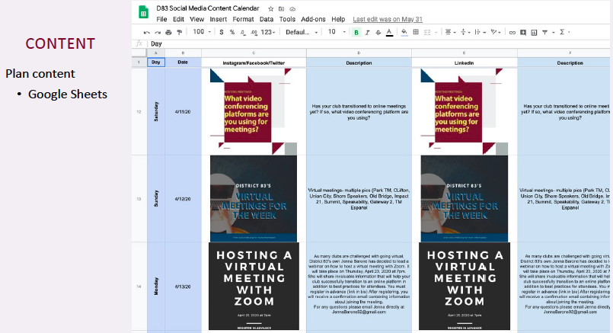

Slide 22
Brainstorm Session
What are some way your clubs use social media for promotion and membership building?
How could you apply some of the things we learned today to help promote your club?

Slide 23
D27 Social Media Workshop Series

Slide 24
Questions? Comments?

